Slide 1
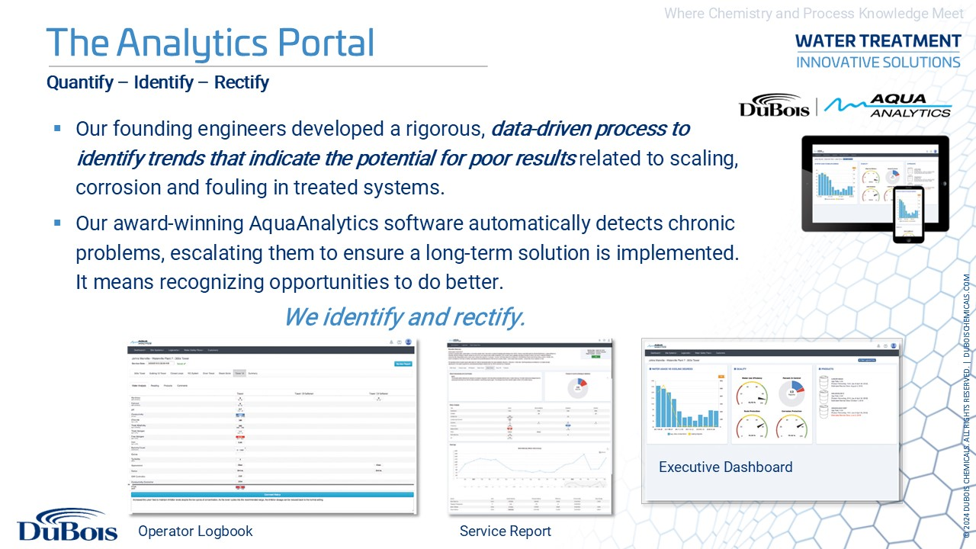

Slide 2
DuBois Analytics Interactive Service Report

Slide 3
Process Control
Pre-Analytics Average Concentration: 7.4%
Post-Analytics Average Concentration: 6.5%
12% reduction

Slide 4
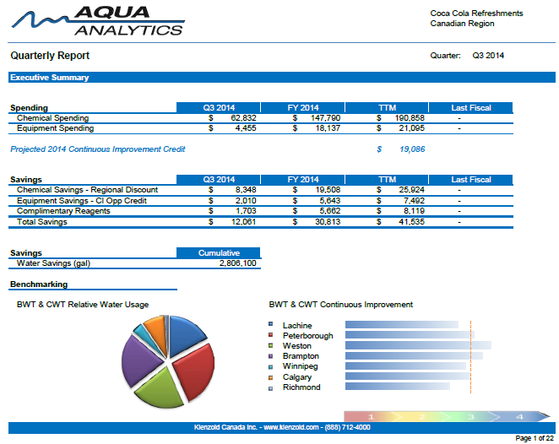
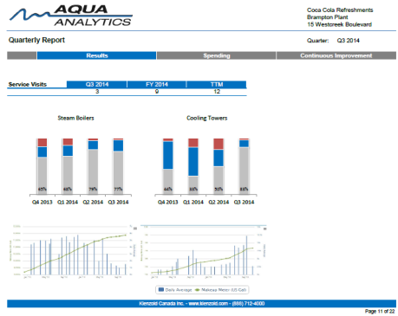
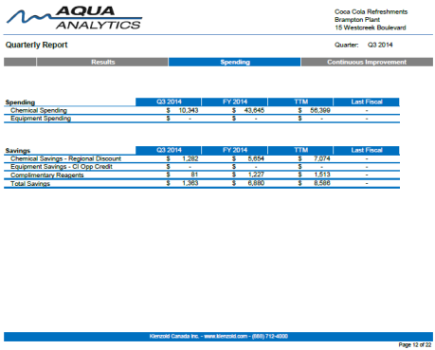
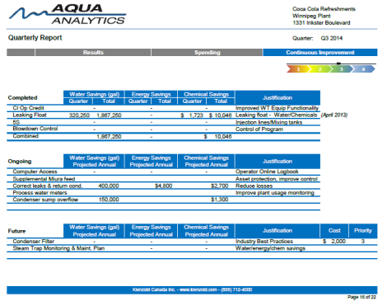
Annual Reporting: System Benchmarking
Notes:
And what this allows us to do, is it provides us with the necessary data to produce quarterly reports that can compare one plant to another and highlight areas where there is potentially more incentive for Improvement or Intervention. We really feel this is unique in the marketplace and it starts with consistency at the plant level.
Key Points:
Necessary data for accurate quarterly reports
Highlight areas where there is more incentive…
Unique – accurate because of consistency at the plant level
Build quarterly report unique to JM that is built from our standard reporting

Slide 5
Boiler System: Initial Results
Boiler Conductivity
Boiler Hardness
Boiler Sulfite
Boiler Sulfite

Slide 6
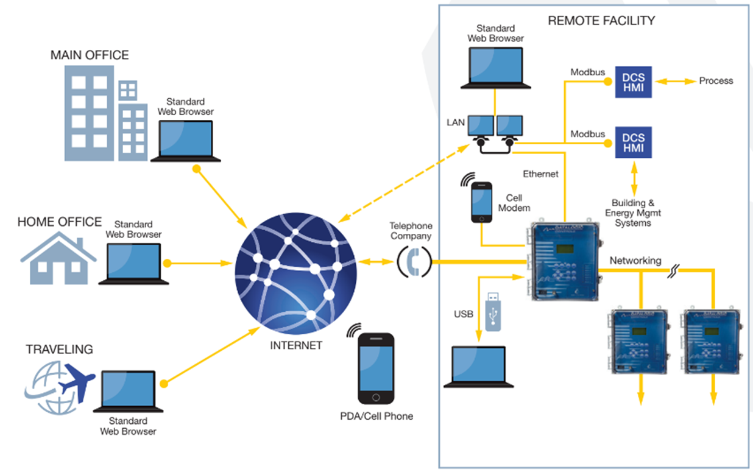
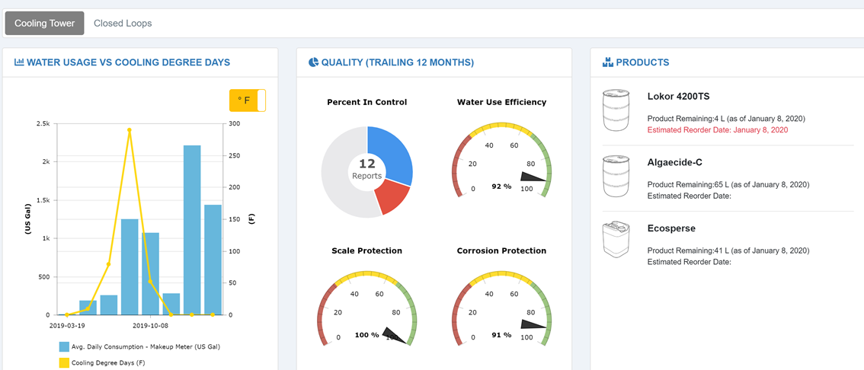
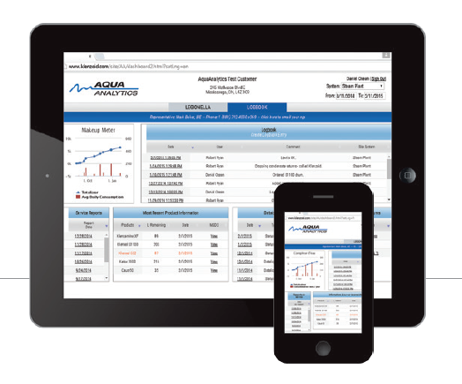
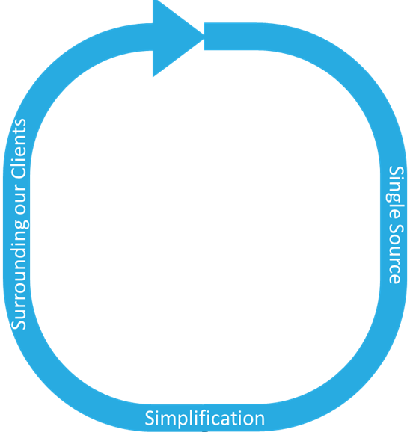
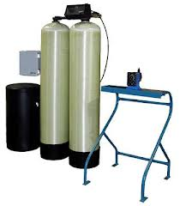
Analytics Platform: Manage Processes & Predict Trends
Broad Chemistry Solutions
Equipment
Our data-driven processes drive our clients to the lowest possible life-cycle cost and actively maintain them there
A Team of Industry Experts
Helping you control what you measure to protect people, the environment and mission critical equipment
Automation & Online control
IDENTIFY, QUANTIFY, RECTIFY
Notes:
ISO 17025 - standard for which most labs must hold accreditation in order to be deemed technically competent.

Slide 7
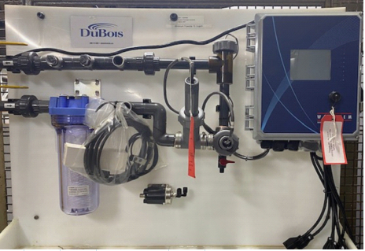
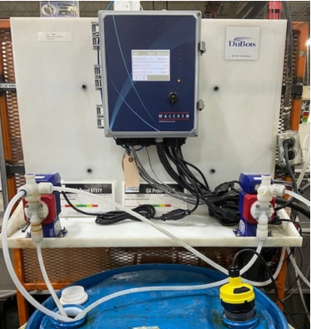
Automation
Treatment control Program Assembly
Allows for precise control, monitoring, and optimization of your chemical program
Pre-fabricated panel contains equipment to monitor your water usage and overall program performance while controlling the dosing of chemical products through precise metering pumps or other components
Your device can receive all readings in real time using our DuBois Analytics software. Each panel can be customized to include
• Online controller with monitoring capabilities
• Cellular modem with remote notification
• Data logging of various key parameters
• Water meters
• Automated valves
• Timers
• Chemical dosing pumps with injection assemblies
• Filtration
• Sensors to measure and control:
- Conductivity
- pH
- Refraction value
- Corrosion Rate
- ORP
- Fluorescence
- Temperature/Pressure
- Any 4-20 mA input/output card option

Slide 8
Increased Control
Powerplant Free Halogen Results

